Slide 1



GraphQL with Hot Chocolate
Part II
Thomas Freudenberg
@thoemmi
Robert Meyer
@roeb
Alex Dörfler
@AlexDoerfler

Slide 2
Whats the plan?
In the next 3 hours we will look at:
Structure of Hot Chocolate Project
What is Relay?
Middlewares
Pagination, Projection, Filters & Sorting

Slide 3
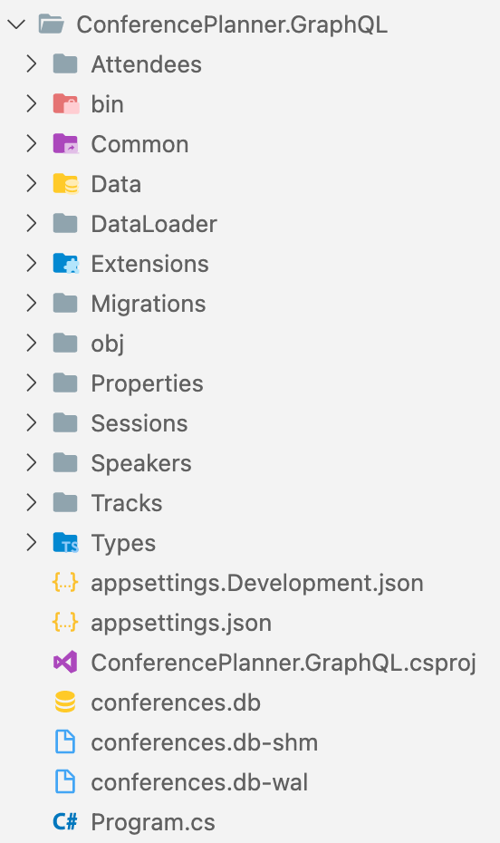
How to structure a GraphQL Project
You can structure your project with the following rules:
Collect all DataLoaders in one folder
DbContext and Data Entities in a Data Folder
All ObjectType Resolvers in one Folder
Separate all Query Topics (Speaker, Sessions, ..) in own Folders. - Queries, Mutation & Subscriptions
- Input & Payload Definitions/Classes
⚠️ This is only a suggestion and is not applicable to every scenario

Slide 4
GraphQL: Relay
Relay is a JavaScript framework for building data-driven React applications with GraphQL
Developed & used by Facebook
Relay proposes some schema design principles for GraphQL servers in order to more efficiently fetch, refetch and cache entities on the client

Slide 5
GraphQL: Global identifiers
ID Fields are used by GraphQL clients to build a flat cache with the unique identifier.
This can become a problem if two records of different types have the same IDs.
Hot Chocolate solving this problem with: Global identifiers.
A global identifier is a base64 string which contains the following information:
- Type of the entity
- ID of the entitiy
- Datatype of the ID

Slide 6
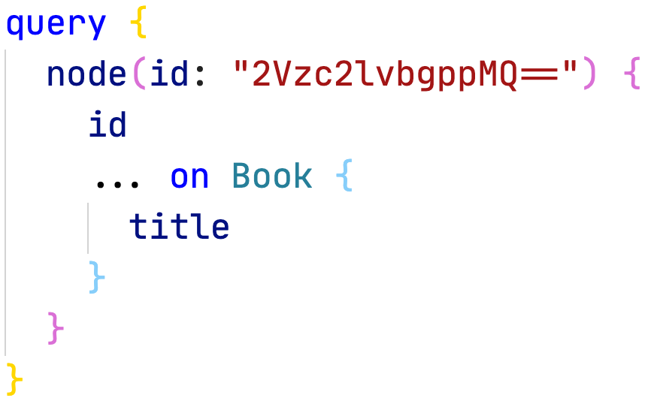
GraphQL: Global Object Identification
The schema provide a standard mechanism for asking for an object by ID
Objects with identifiers are referred as “nodes”

Slide 7
👨‍🏫 Use Relay with Hot Chocolate
We will:
Activate the Relay pattern in Hot Chocolate
Implement a basic Error Handling

Slide 8

👷‍♂️ Challenge #3: GraphQL schema design approaches
Now it's your turn!
In this exercise you will implement the node pattern and get your code into a good structure.
https://github.com/CloudKlabauter/HotChocolateWorkshop

Slide 9
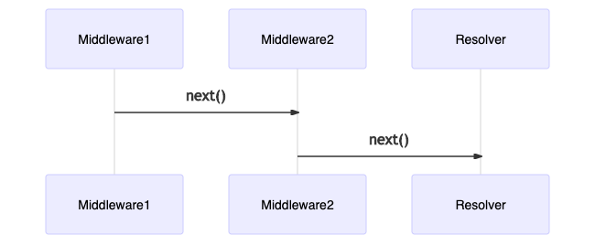
GraphQL: Middlewares
The field middleware is one of the foundational components in Hot Chocolate. For example: The ID transformation from internal IDs to global object identifiers, are a field middleware
Each middleware knows about the next middleware component in its chain

Slide 10
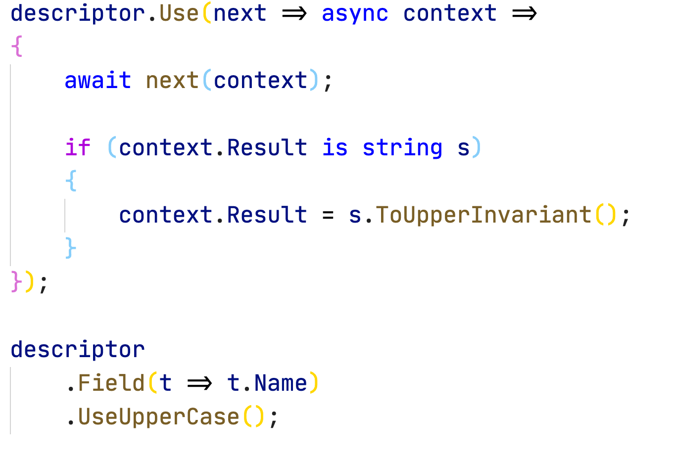
GraphQL: Middlewares
The following middleware takes care that the value of the field is always printed in upper case.
The above middleware first invokes the next middleware, and by doing so, gives up control and lets the rest of the pipeline do its job.

Slide 11
GraphQL: Pagination
Pagination is one of the most common problems that we have to solve when implementing our backend.
The challenge is to load from a large list of data exactly the data that should be displayed.
There are two common ways to implement pagination:
- Connections
- Offset-Pagination
Connections should be preferred to Offset Pagination.
Connections provide an abstraction which makes it easier to switch to another pagination mechanism later on.

Slide 12
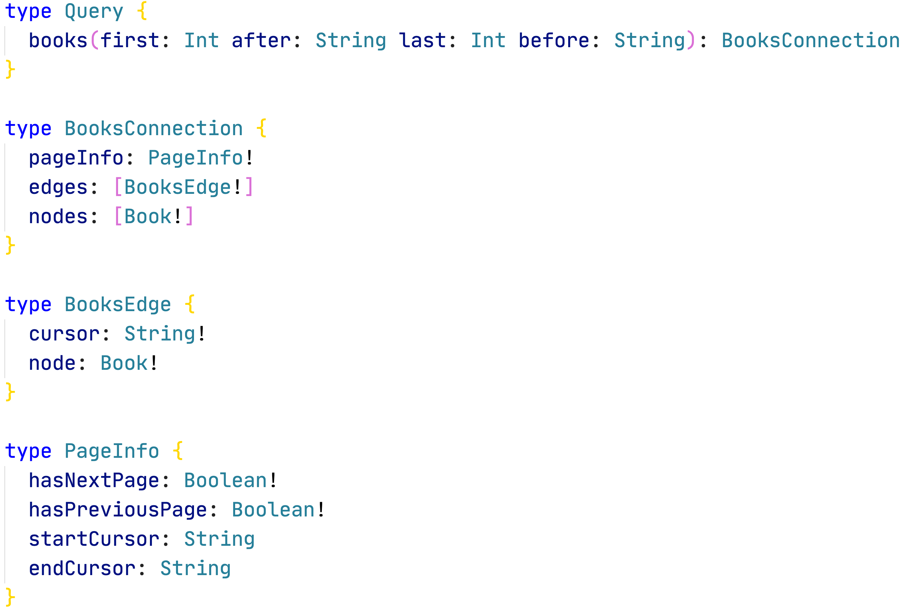
Pagination: Connections
Connections are a standardized way to expose pagination to clients.
Instead of returning a list of entries, we return a Connection.

Slide 13
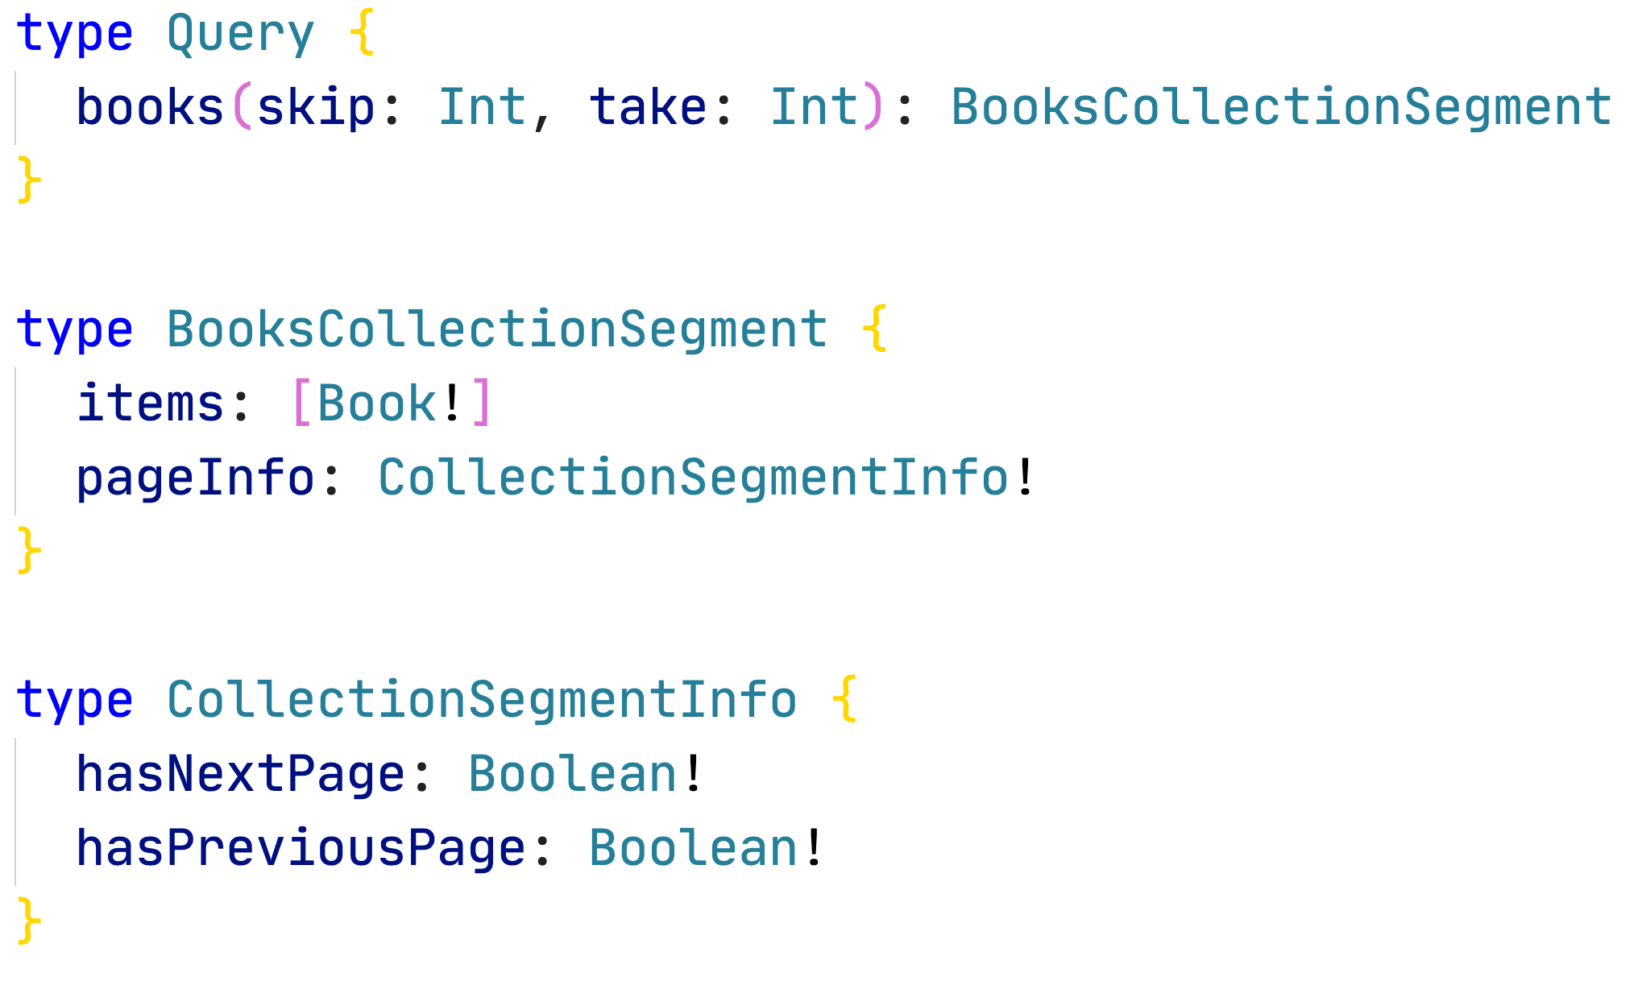
Pagination: Offset-Pagination
The client requests parameters with a specific limit:
The number of records that need to be skipped
The number of results

Slide 14
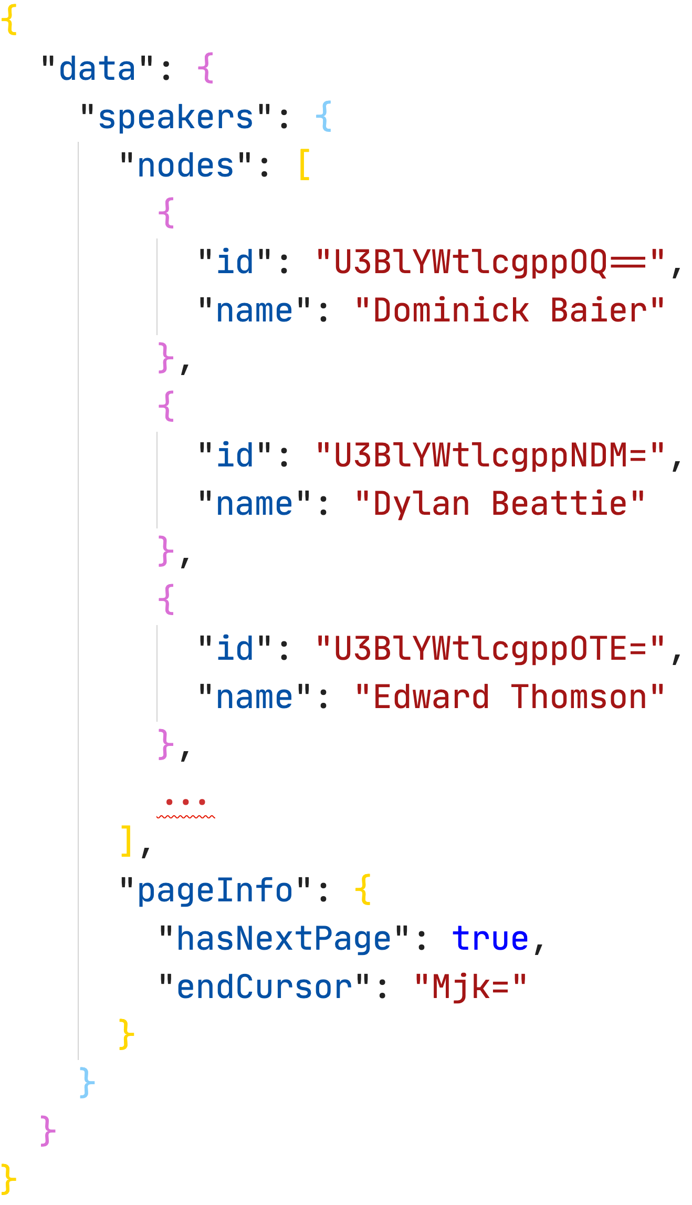
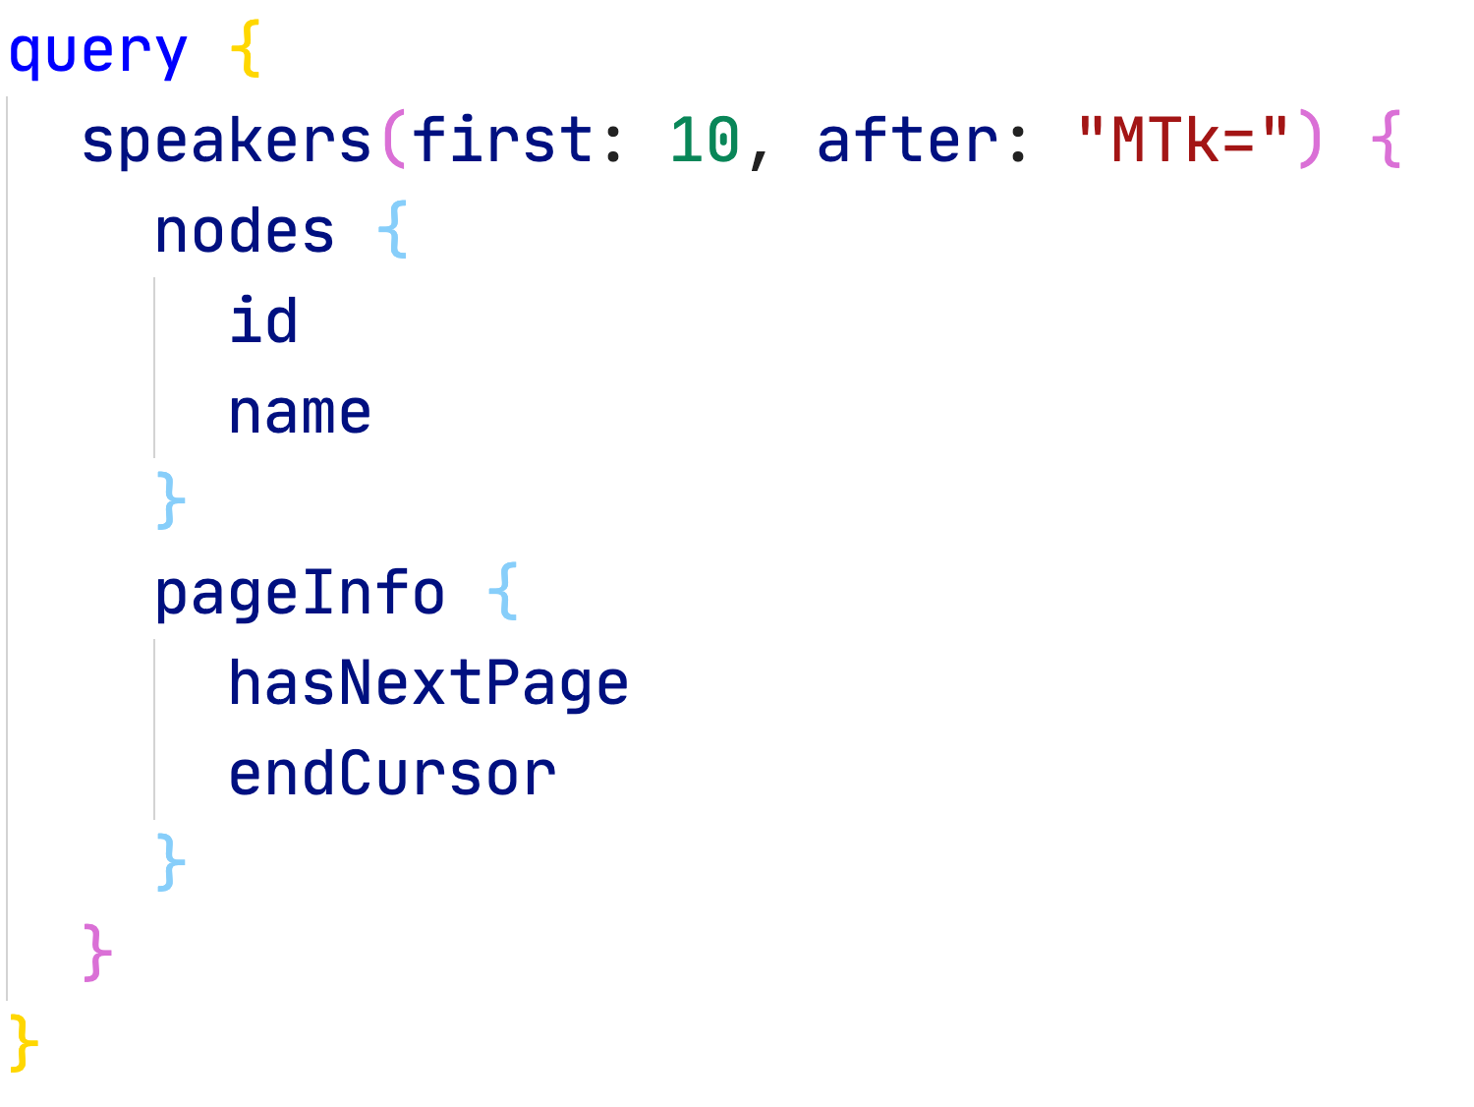
GraphQL: Execute Pagination

Slide 15
GraphQL: Projection
Hot Chocolate projections directly projects incoming queries to the database
Goal: Reduce or even eliminate over or under fetching
Projections can be registered globally or on each separate field
Projections are required to send the filtering through the database.

Slide 16
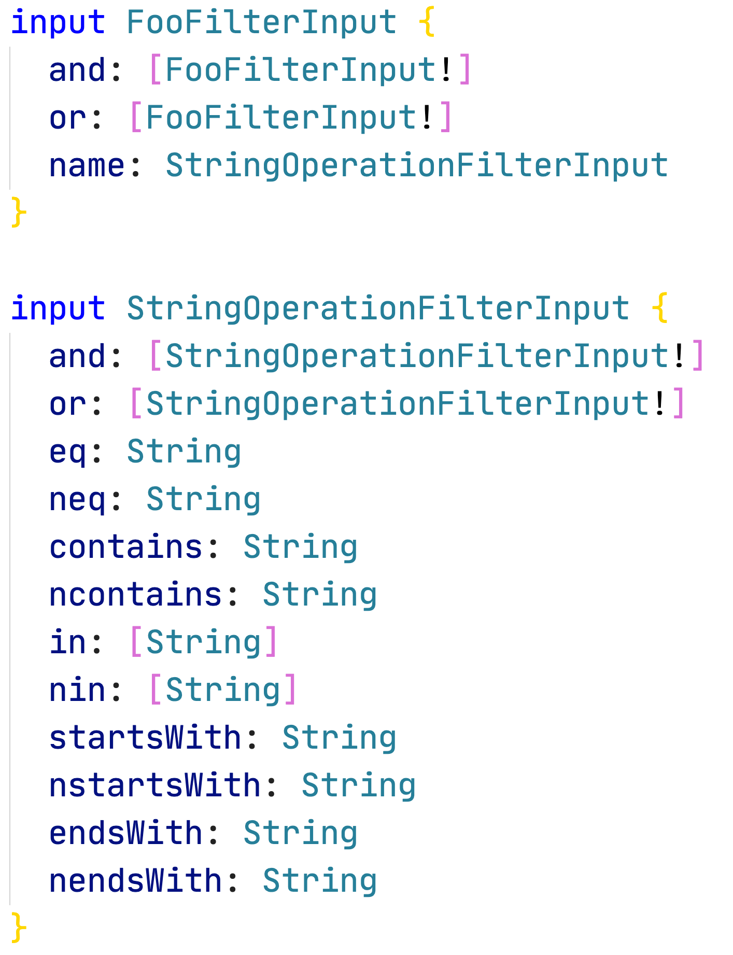
GraphQL: Filtering
You can expose complex filter objects through your GraphQL API that translates to native database queries.
Filter implementation translates filters to expression trees that are applied to IQueryable
Hot Chocolate will inspect your .NET model and infer the possible filter operations from it.
You can customize the filter with a fluent API to ignore some fields from your schema and which operation are allowed.

Slide 17
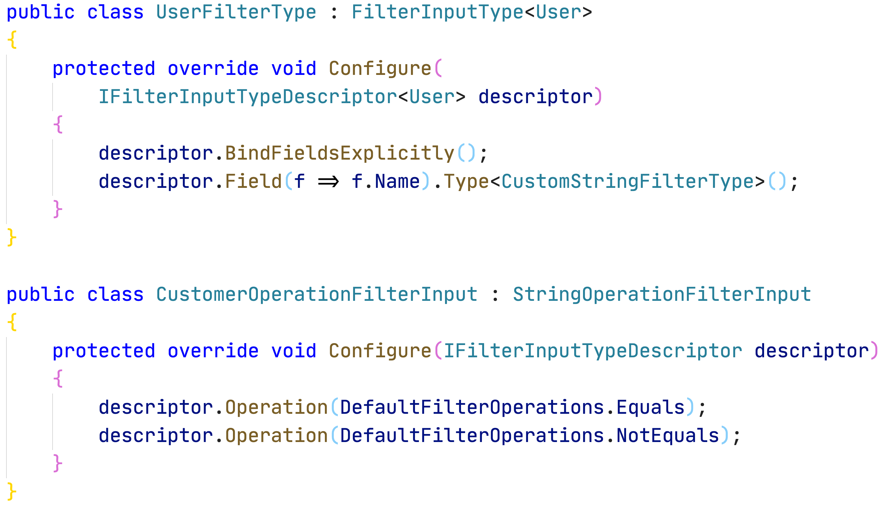
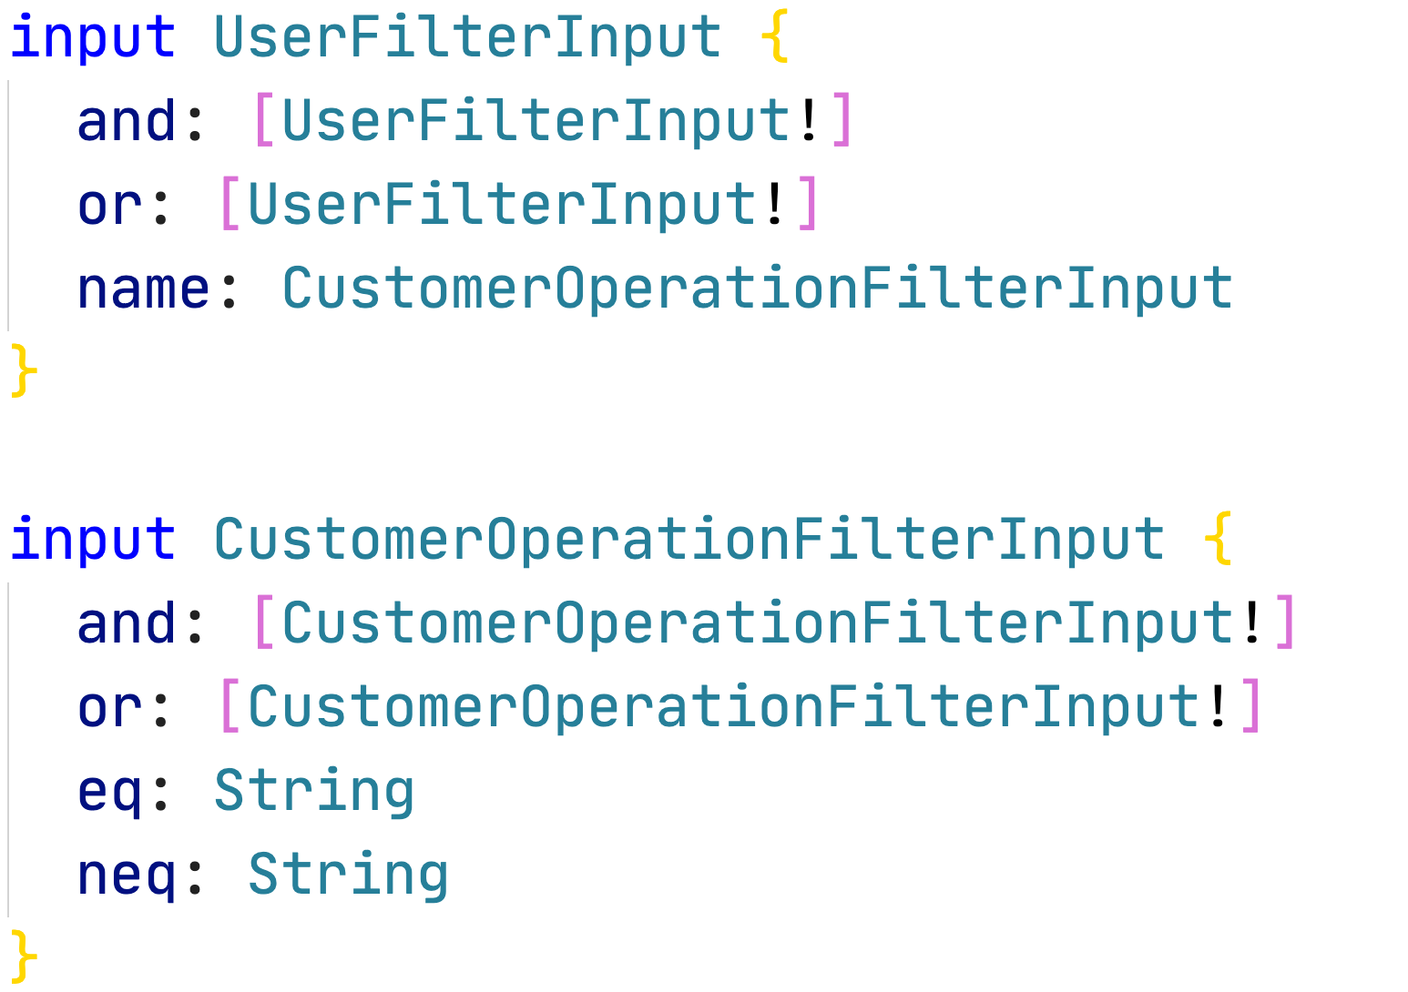
GraphQL: Custom Filtering

Slide 18
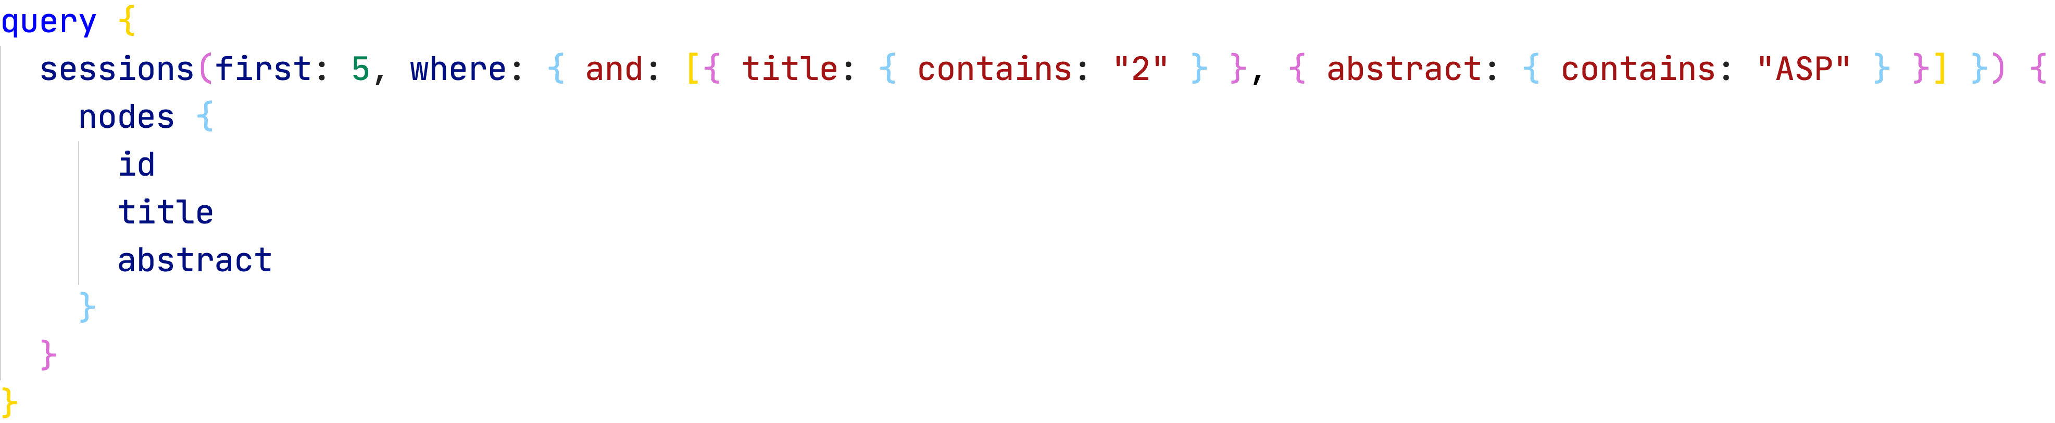
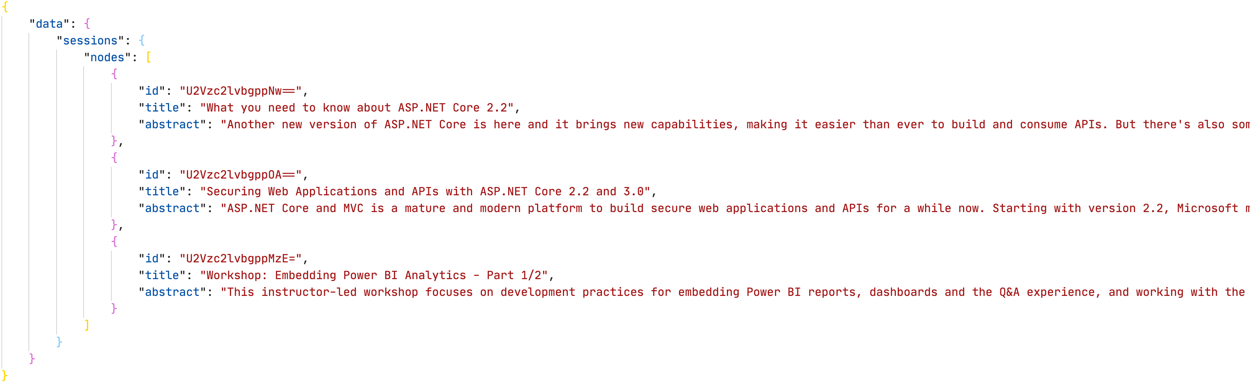
GraphQL: Execution Filtering

Slide 19
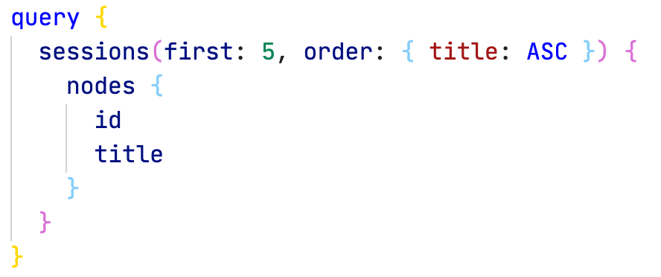
GraphQL: Sorting
Sorting means, you can order a list of elements ascending and descending.
The default sort implementation translates sorting statements to expression trees that are applied to IQueryable

Slide 20
👨‍🏫 Use Filtering, Pagination & Sorting with Hot Chocolate
We will:
Implement basic filtering, sorting and pagination in our demo project

Slide 21
👷‍♂️ Challenge #4: Middleware & Filters
Now it's your turn!
In this exercise you learn to understand middlewares and implement complex filters
https://github.com/CloudKlabauter/HotChocolateWorkshop

Slide 22
☕️ Coffee Brake
We break for 15 min!
Enjoy your coffee!

